Slide 1
Predict stock movement using daily stock price data & News headlines
Team Members: Arundhathi Patil
Bibin Jose
Nidhi Parashar

Slide 2
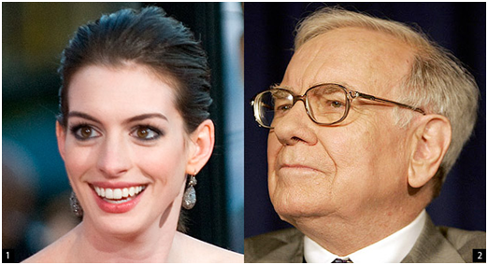
Emotion to Algorithm
In 2011, a Huffington Post blogger noted a funny trend.
When Anne Hathaway was in the news, Warren Buffet’s Berkshires’s Hathaway shares went up.

Slide 3
Firms that do Sentiment Analysis
Two Sigma Investments
D. E. Shaw
Hedge funds:
Renaissance Technologies
Hudson River Trading
If the algorithm can react to a positive news article faster than anyone else in the market, they can make the profit that is the jump in price.

Slide 4
Data Collection
News Data
Stock Market Data
Historical news headlines from Reddit World News Channel(/r/worldnews).
Top 25 headlines for each date considered.
Date Range: 2008-08-08 to 2016-07-01
Dow Jones Industrial Average (DJIA) data
Date, Open, High, Low, Volume, Close, Adjusted close
Added another column – Start trend

Slide 5
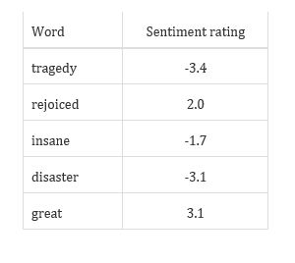
News Headlines Sentiment Analysis
VADER ( Valence Aware Dictionary and Sentiment Reasoner) python package for sentiment analysis of social media text like Twitter data, News data, Facebook data etc.
Based on lexicon of sentiment related words.
Generates 4 sentiment metrics : positive, negative, neutral and compound.
Recognizes capitalism of words as well.
Also considers words before the sentiment word. Ex: “Extremely bad”

Slide 6
Training Models
Different models based on splitting of the data:
Training data - 6 years, Testing data - 2 years
Training data – 80 percent of data, Testing data – 20 percent of data without shuffling
Models applied:
Logistic Regression
K-Nearest Neighbors
Decision tree
SVM
XGboost

Slide 7
Comparing Model Performance
Algorithm | Accuracy with sentiment (%) | Accuracy with start trend and sentiment
Logistic Regression | 51.2 | 59.86
KNN | 50.17 | 53.00
Decision Tree | 48.54 | 52.05
Gaussian Naive Bayes | 50.08 | 61.49
SVM | 53.08 | 62.17
Random Forest | 51.45 | 56.68
XGBoost | 51.02 | 57.20
Taking data from 2008-08-08 to 2014-12-31 as train and 2015-01-01 to 2016-07-01 as test

Slide 8
Comparing Model Performance
Algorithm | Accuracy with sentiment (%) | Accuracy with start trend and sentiment
Logistic Regression | 50.0 | 63.31
KNN | 46.98 | 57.03
Decision Tree | 50.75 | 54.52
Gaussian Naive Bayes | 51.25 | 61.80
SVM | 50.75 | 66.33
Random Forest | 46.98 | 57.78
XGBoost | 48.49 | 62.31
Taking 80% of data as train and 20% as test

Slide 9
Conclusions
Naïve Bayes, SVM and XGboost classifier gives better results but no model works really well
May be actual article data rather than just headlines data could give more better results
More information could have been included in the model, such as the previous day's change, the previous day's main headline(s).

Slide 10
Future Work
Planning to add financial news headlines related to the companies in the DOW Jones Index to see if prediction accuracy improves.
Predicting stock movement of specific companies.
Adding social media data like tweets about stock market.

Slide 11
Thank you !!

